Slide 1
PC/104
Tom Rethard

Slide 2
What Is PC/104?
A standard for PC-compatible circuit boards used to build embedded systems
  Boards can be stacked
  PC-compatible
  Common bus between boards
  Designed for minimal power (1-2 watts)
  4” x 4” form factor
  104 Pins in the Stackable Connector for ISA bus
  based on IEEE-P996

Slide 3
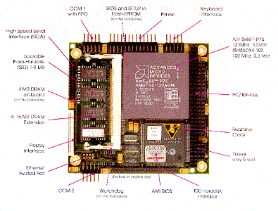
Typical PC/104 Board

Slide 4
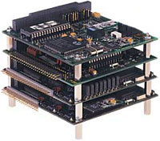
A Stack of PC/104s

Slide 5
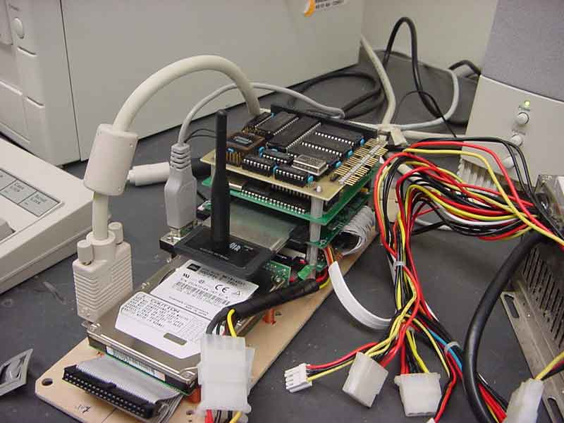

Slide 6
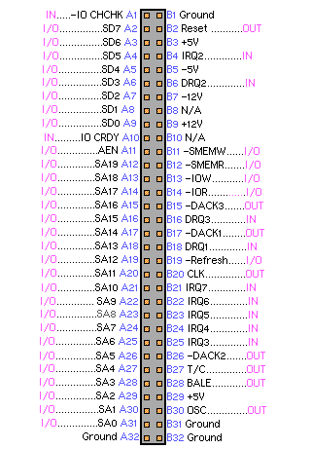

Slide 7
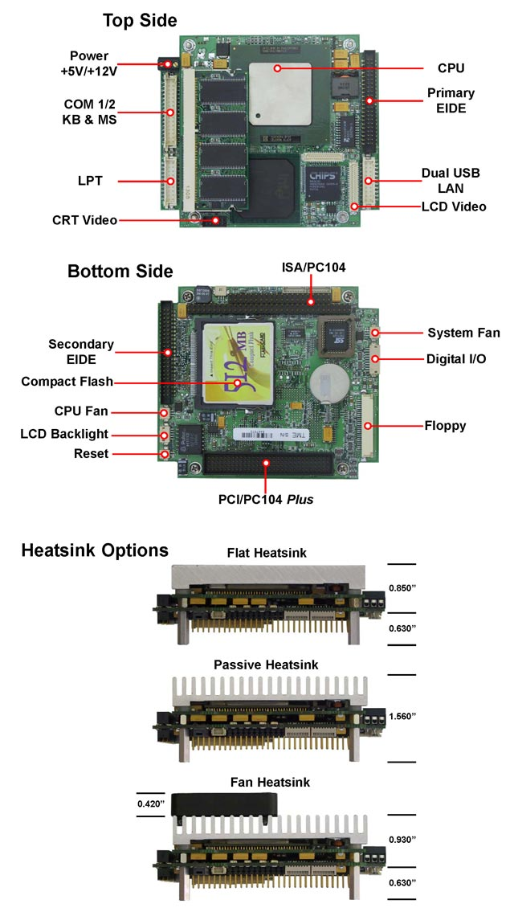

Slide 8
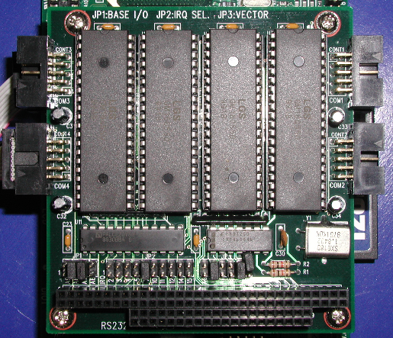

Slide 9
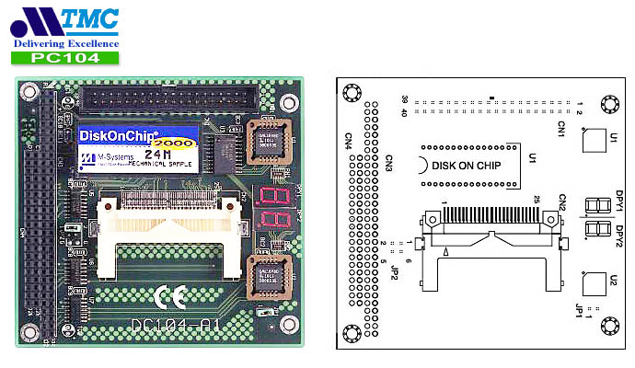

Slide 10
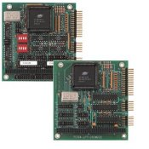

Slide 11
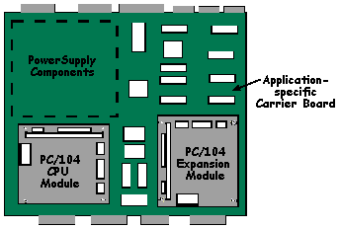

Slide 12
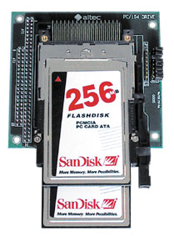

Slide 13
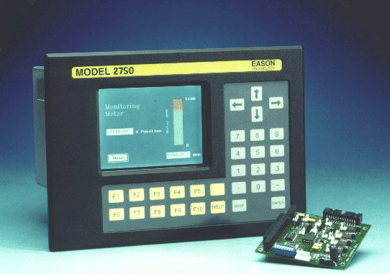

Slide 14
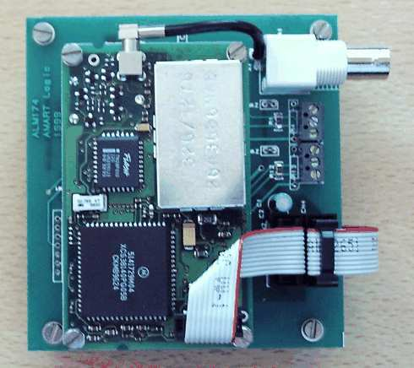

Slide 15
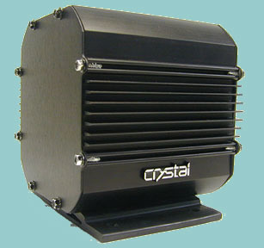

Slide 16
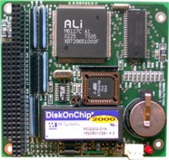

Slide 17
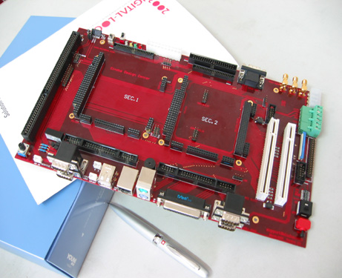

Slide 18
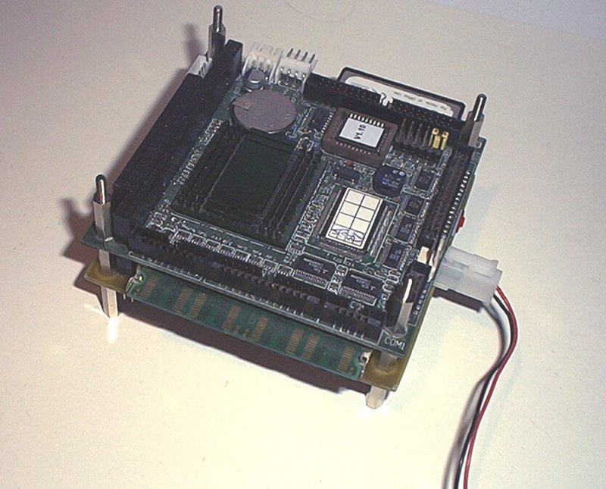

Slide 19
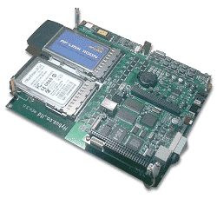

Slide 20
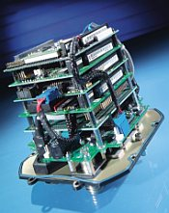

Slide 21
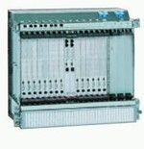

Slide 22
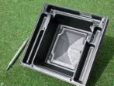

Slide 23
Board Types
CPU
Video Controllers
Network Interfaces
Sound
Data Acquisition
Specialized
Almost anything you could ask for

Slide 24
PC/104-Plus
Similar to PC/104
Adds a “Plus Connector” – basically a PCI bus
  120 more pins
  2mm spacing
  Runs “PCI-104” bus
Spec at http://www.controlled.com/pc104/consp5.html
ISA bus may eventually disappear

Slide 25
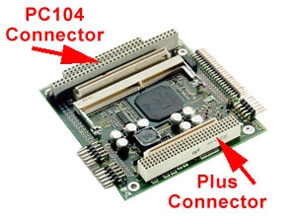
Typical PC/104-Plus Board

Slide 26
More Standards: EBX
Embedded Board eXpandable
non-backplane embedded controller
  may contain PC/104 Plus modules
8” x 5.75” form factor

Slide 27
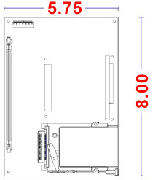
Basic EBX Layout

Slide 33
Credits
http://www.controlled.com/pc104faq/#pc104
http://www.pc104.org/

